Slide 1
Benchmarking Ascon
ECE 4301
12/8/2025
Group C: Garima Bhattarai, Mia Diliberti-Brandenburg, Marcelo P. Masilungan, John Pollak, Kelly Williams

Slide 2

Why Ascon and LWC Matters
Fall 2025
18.5 billion IoT devices connected in 2024 [1]
32% use Wi-Fi, 24% use Bluetooth [1]
Both need encryption [2][3]
However, encryption is computationally heavy
Ascon/LWC close the performance-security
gap [4]
https://iot-analytics.com/number-connected-iot-devices/
https://www.bluetooth.com/wp-content/uploads/Files/Specification/HTML/Core-54/out/en/low-energy-controller/low-energy-link-layer-security.html
https://documentation.meraki.com/Wireless/Design_and_Configure/Architecture_and_Best_Practices/Wireless_Fundamentals%3A_Encryption_and_Authentication
https://www.nist.gov/news-events/news/2023/02/nist-selects-lightweight-cryptography-algorithms-protect-small-devices

Slide 3
Original Project Idea
From the Project Vision

Slide 4
Project Vision
Raspberry Pi 5
Raspberry Pi 4b
Raspberry Pi 3b+
Raspberry Pi Zero W
ARM Cortex A-76
ARM Cortex A-72
ARM Cortex A-53
ARM1176JZF-S
Tools
Fall 2025
Studying the lightweight cryptographic primitives of ASCON, which uses sponge construction modeling using different generations of Raspberry Pi.
Processor: BCM2712
2.4GHz
Quad-core 64-bit
Up to 16 GB LPDDR4 SDRAM
Processor: BCM2711
1.5GHz
Quad-core 64-bit
Up to 8GB LPDDR4 SDRAM
Processor: BCM2837B0
1.4GHz
Quad-core 64-bit
1GB LPDDR2 SDRAM
Processor: BCM2835
700MHz
Single-core 32-bit
512MB LPDDR2 SDRAM
We will use the tools from the NIST LWC Standardization Project that were previously used for benchmarking microcontrollers, and may supplement or replace with other tools if they are seen as more appropriate.
(https://github.com/usnistgov/Lightweight-Cryptography-Benchmarking)
Excel will be used for data analysis and visualization where the included Python scripts are not applicable.
Notes:
Determining feasibility of use of this lightweight cryptographic algorithm on very limited embedded platforms.

Slide 5
Project roadmap
Phase 1: Research
Phase 2: Collect Data
Phase 3: Interpret Results
Objectives
Activities
Deliverables
Fall 2025
Research the Ascon algorithm and NIST benchmarking. Understand the differences between different Pi platforms. Consider any additional tests or feasible platform test additions.
Perform benchmarking. Collect enough data to do meaningful processing later.
Process results and report findings.
Find and understand papers on Ascon and review literature from other benchmarks/reports
Be specific and add as many as you need
Use NIST benchmark tools to benchmark on our available platforms.
Collect detailed data and demos.
Analyze what our results mean and feasibility of using Ascon in place of existing algorithms.
Organize all results in a readable and interesting way.
Report drafted section: understanding/evaluating Ascon
Goals for benchmark data (what equations to use, etc.)
Videos and screenshots of experimental procedure
Raw CSV files with results
Final report with analysis of results and Ascon architecture
Graphs and plots from data
Github repo with raw data, demos, report
All roles will be shared based on need, but certain members will lead:
Research: Mia Benchmarking/Data: Kelly
Demo: John Documentation: Marcelo and Garima

Slide 6
The actual project
From our work

Slide 7
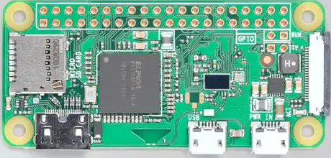
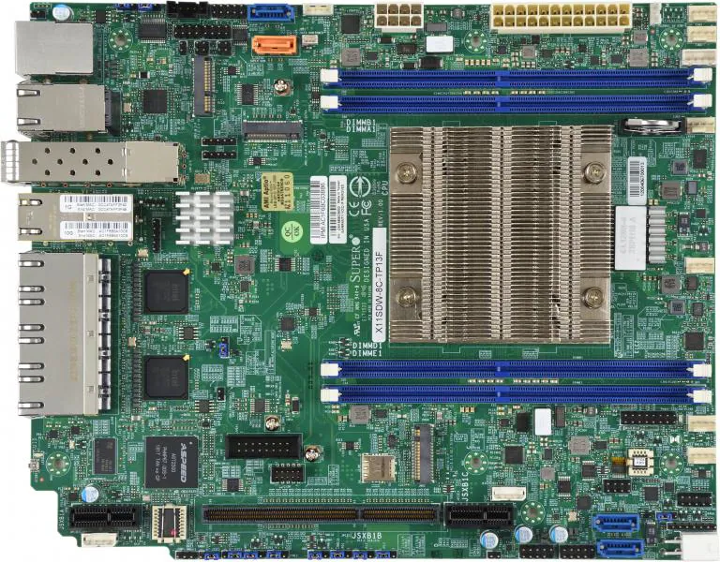
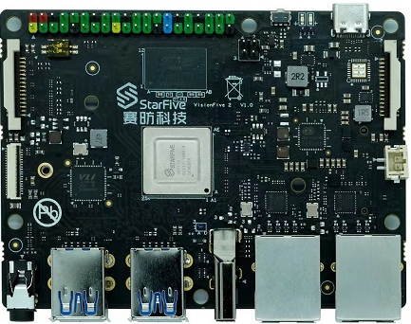
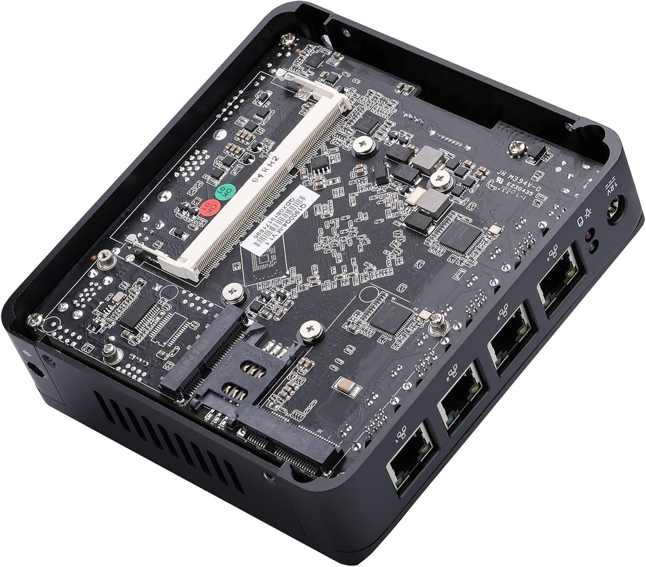
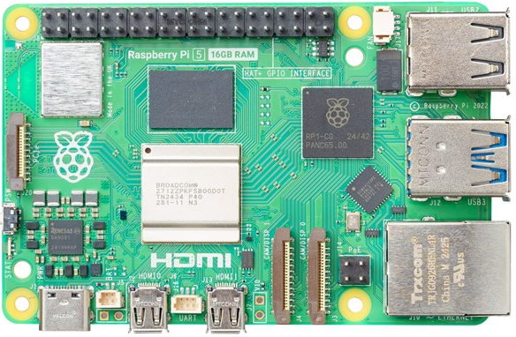
Raspberry Pi Zero W
Supermicro X11SDW-8C-TP13F
VisionFive 2
Qotom Mini PC
Raspberry Pi 5
Hardware
ARM1176JZF-S
Processor: BCM2835
700MHz
Single-core 32-bit
512MB LPDDR2 SDRAM
RISC-V U74
Processor: StarFive JH7110
1.5GHz
Quad-core 64-bit
Up to 8 GB LPDDR4 SDRAM
Intel Skylake-D (x86-64)
Processor: Intel Xeon D-2146NT SoC
2.3 GHz to 3.0 GHz
Up to 512 GB ECC DDR4-2133 LRDIMM
Intel Silvermont (Bay Trail x86-64)
Processor: Intel Bay Trail Celeron SoC
1.83 GHz to 2.66 GHz
Quad-core 64-bit
Up to 8 GB DDR3L
ARM Cortex A-76
Processor: BCM2712
2.4GHz
Quad-core 64-bit
Up to 16 GB LPDDR4 SDRAM
Studied the lightweight cryptographic primitives of ASCON, which uses sponge construction modeling using different three different architectures, ARM, RISC-V and x86

Slide 8
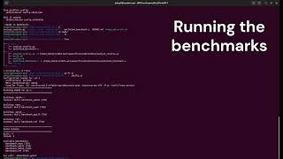
How to run the project

Slide 9
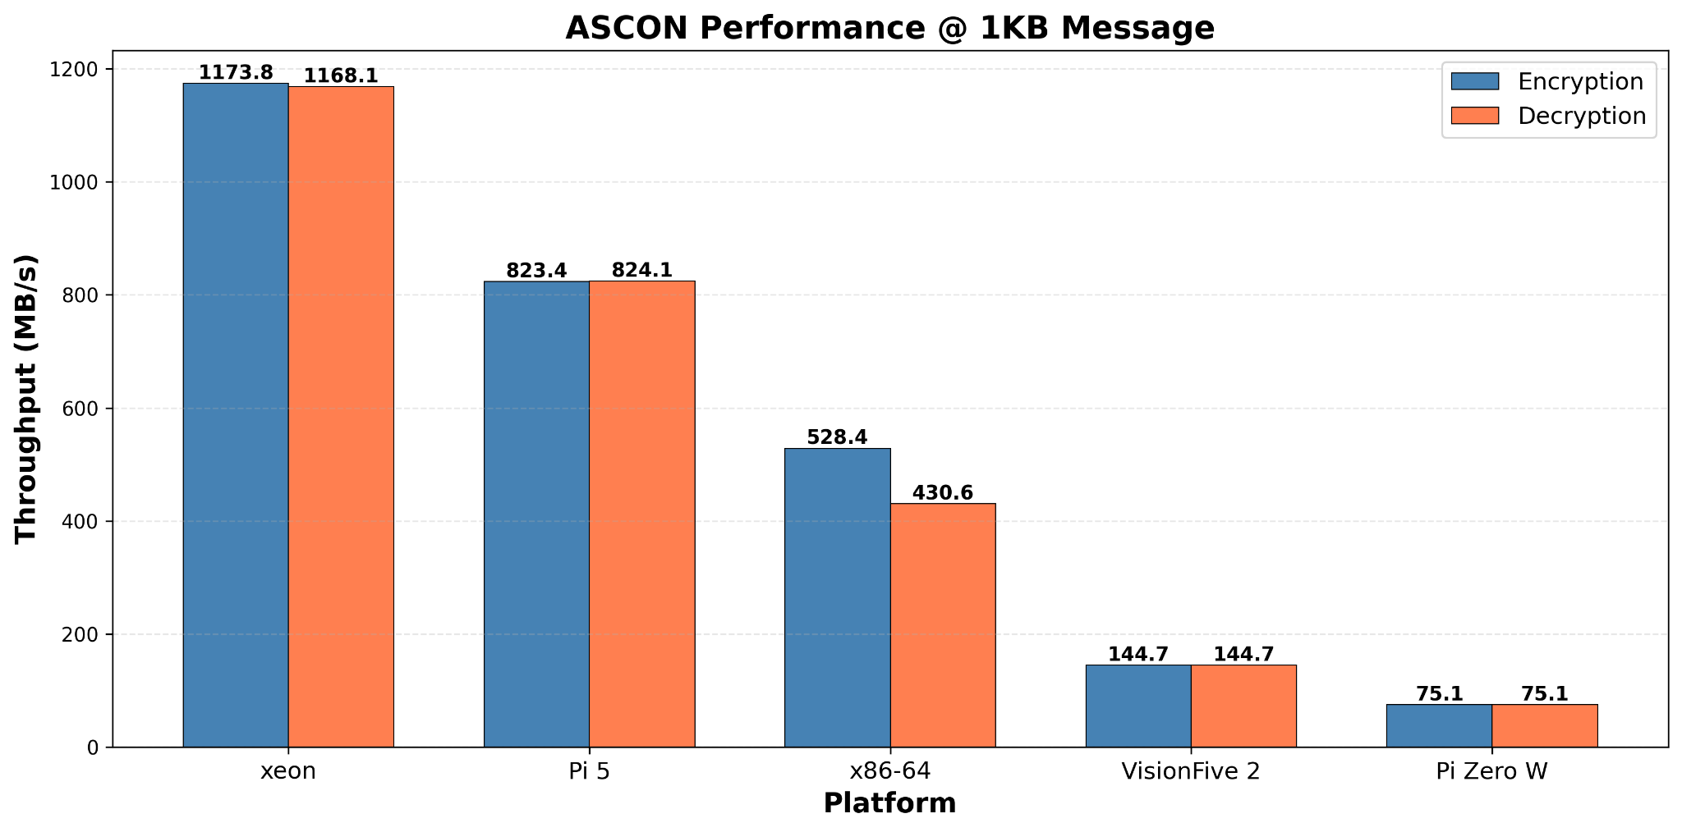

Slide 10
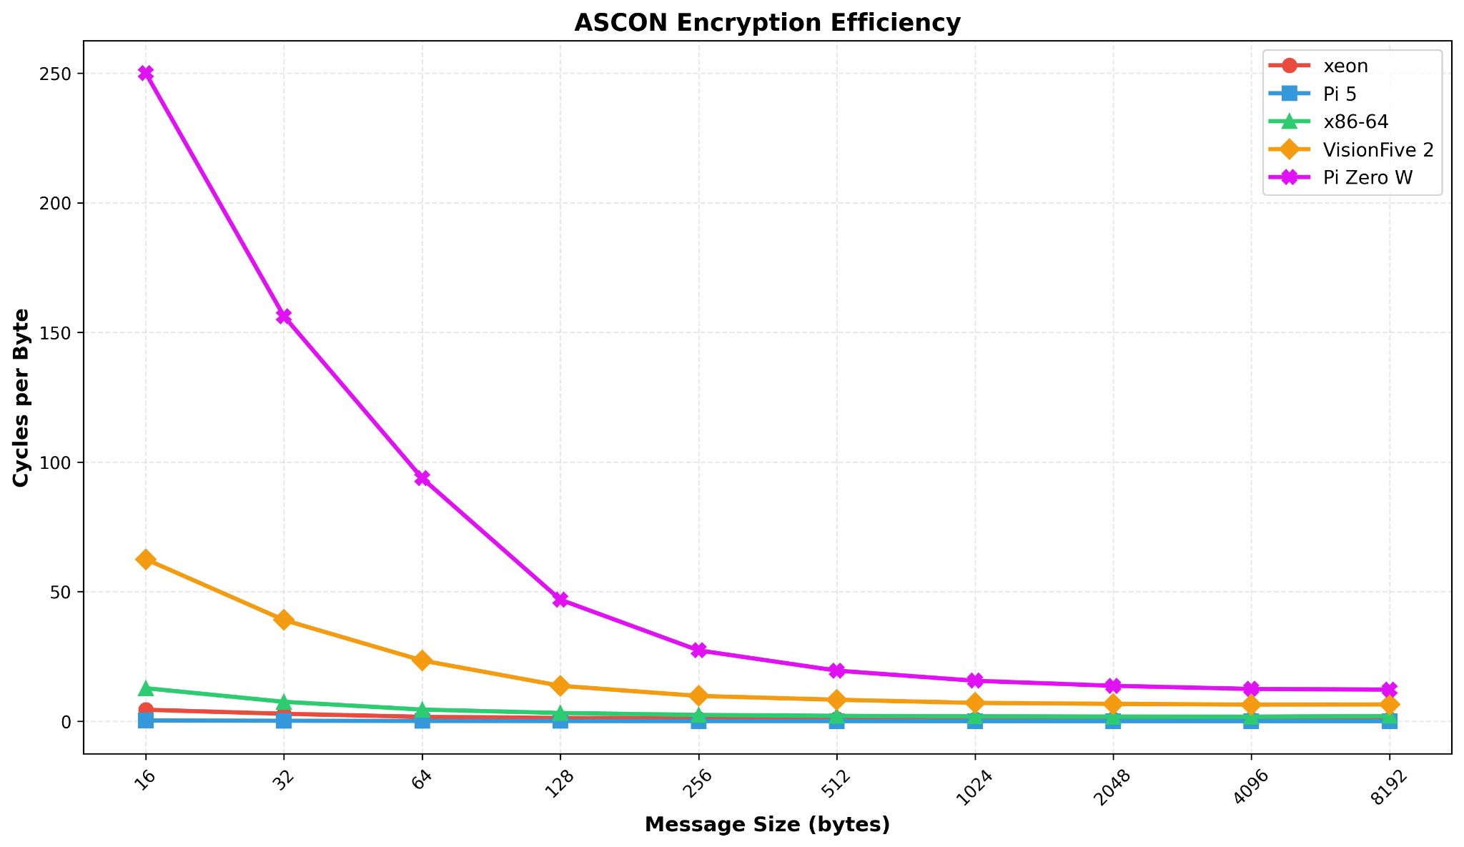

Slide 11
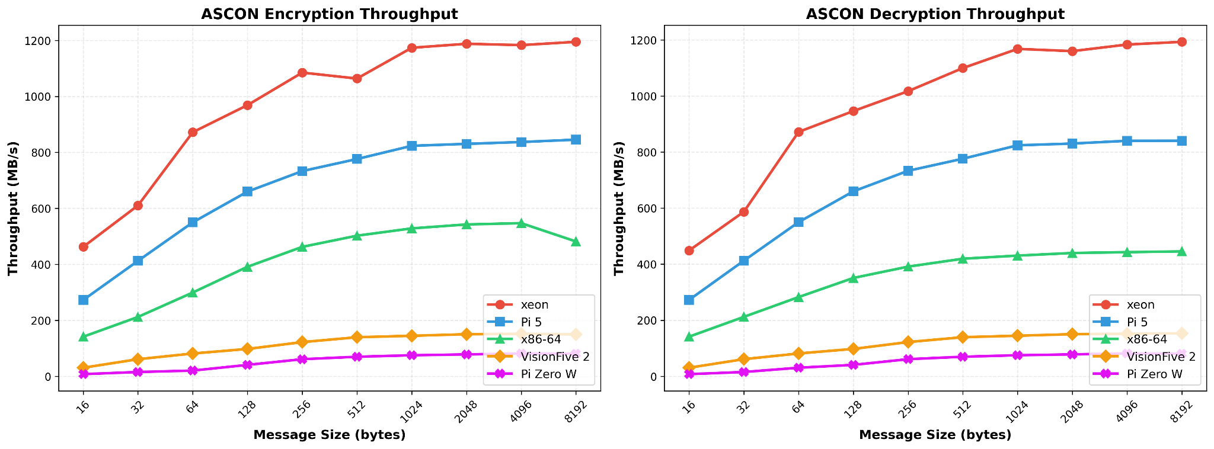

Slide 12
Any questions?
Ask away!

Slide 13
Thank you

